Slide 1

Ethical Hacking Malware detection using machine learning and deep learning Submitted to – Ashish Bajaj Sir
Submitted by - Kabir koli (2K19/IT/064)

Slide 2
Project
My project is malware detection using machine learning and deep learning using Random forest and Logistic regression and neural network model. Then comparing the accuracy of these model to identify which one is best among these.

Slide 3
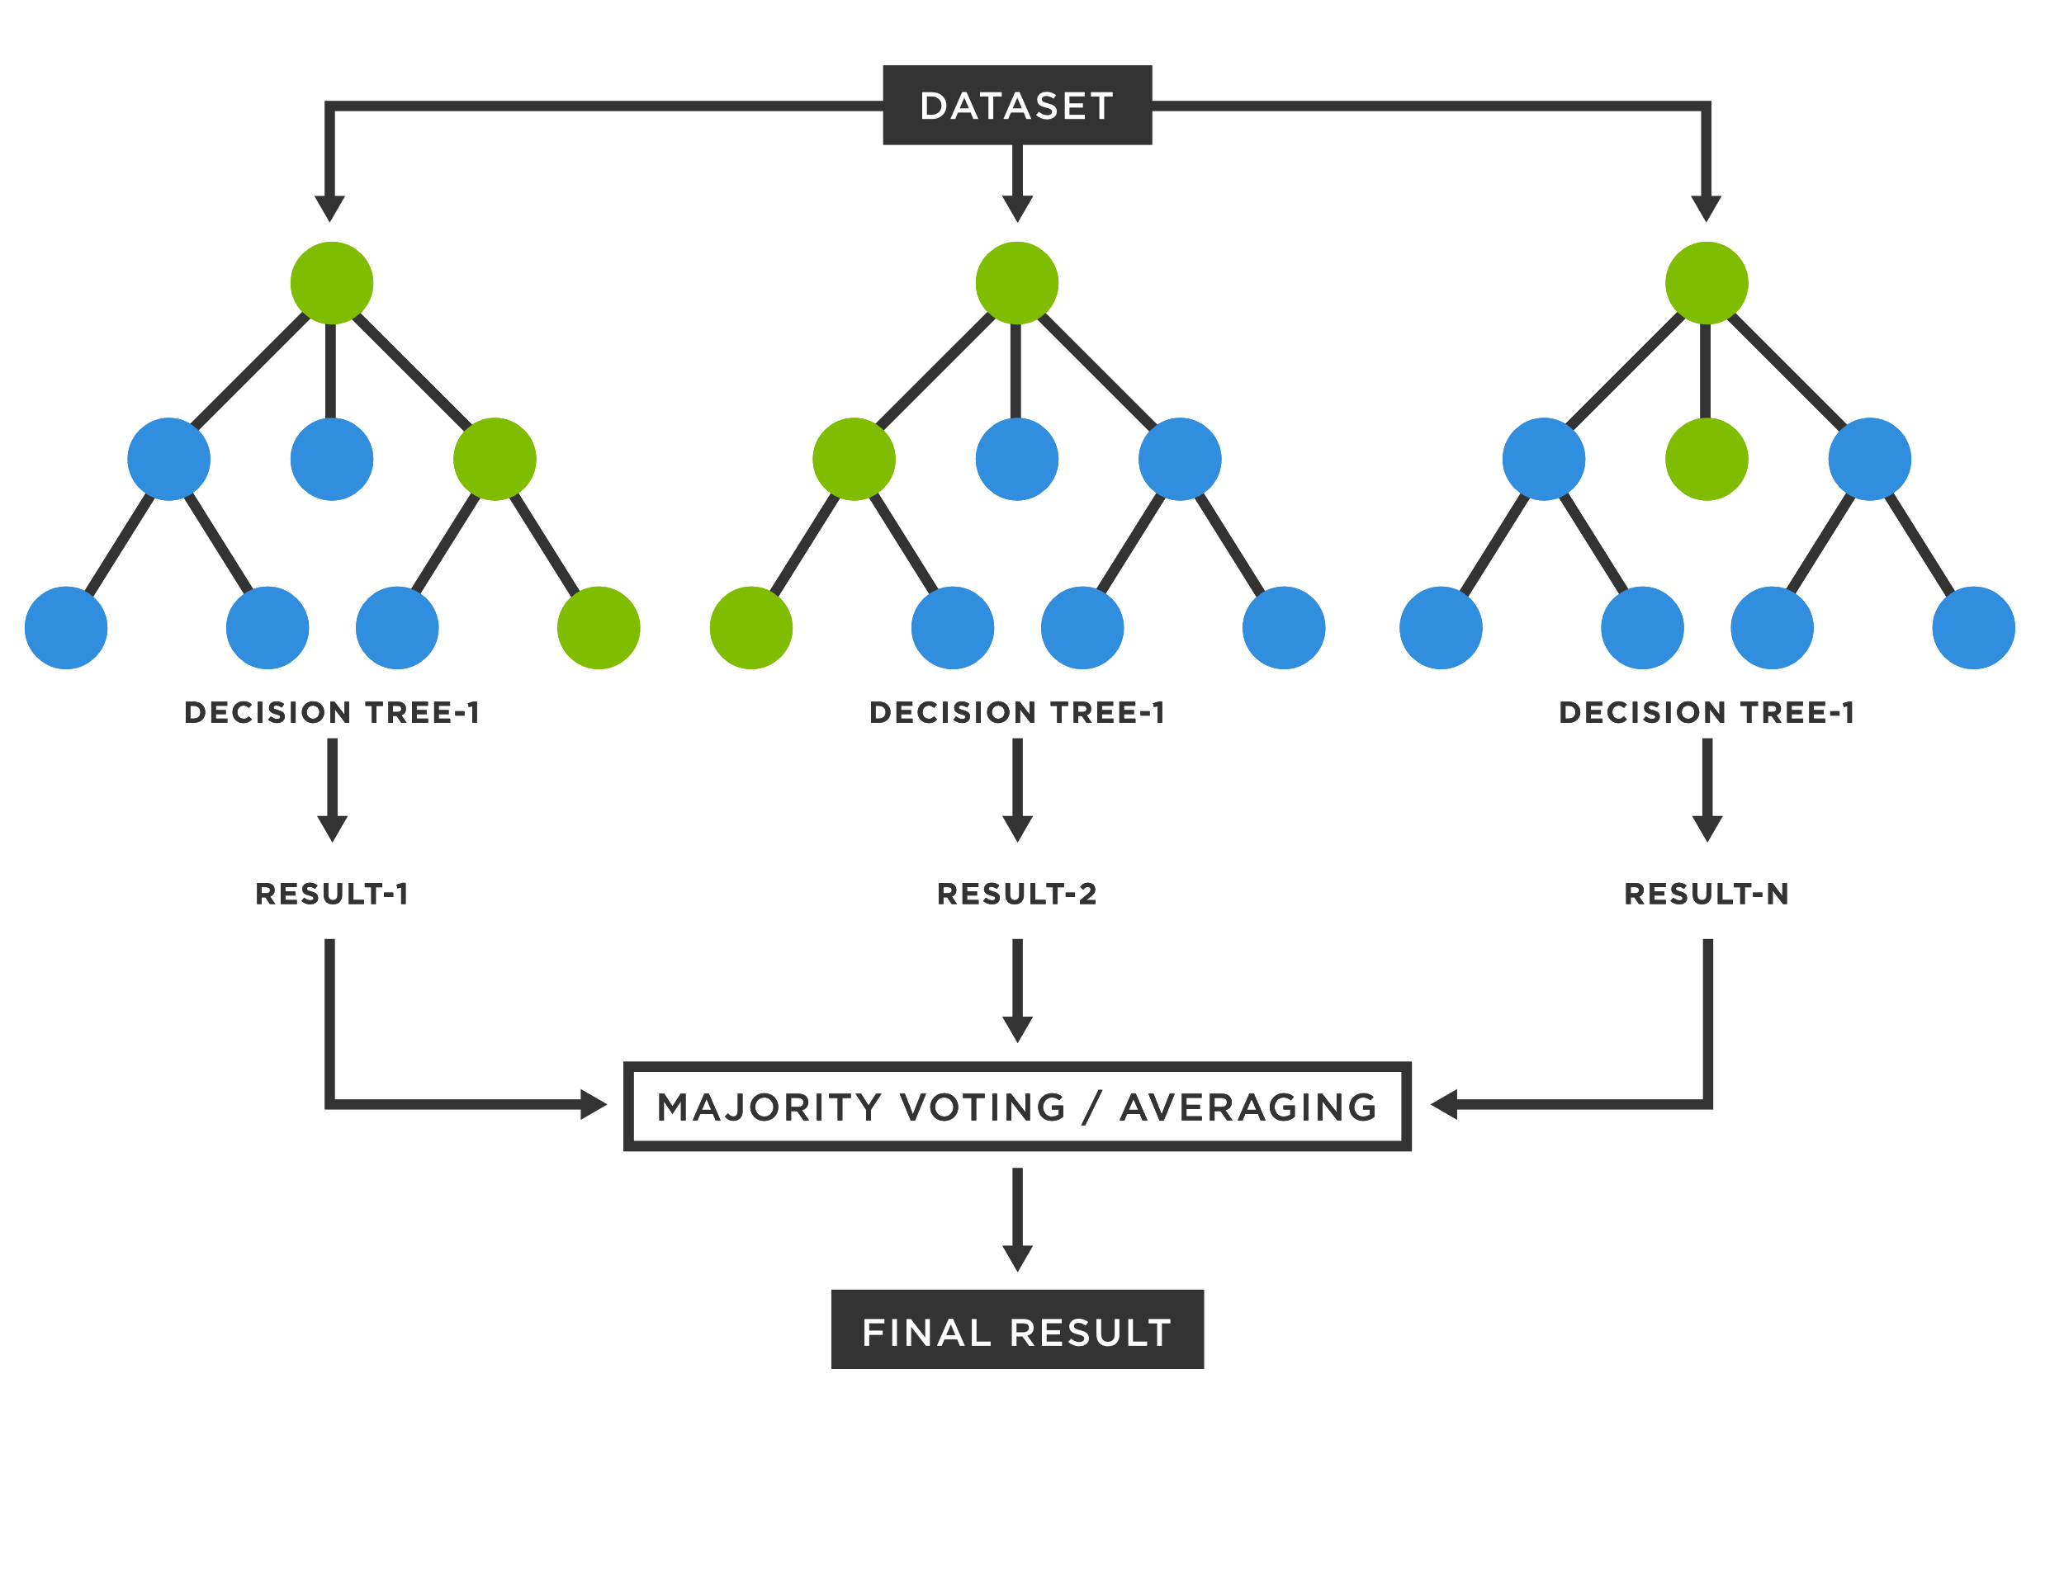
Random Forest
- A random forest is a technique that’s used to solve regression(helps predict a continuous quantity) and classification(predicts discrete class labels) problems.
- The random forest is a classification algorithm consisting of many decisions trees
- The random forest establishes the outcome based on the
predictions of the decision trees.

Slide 4
Operation of Random forest
- A random seed is chosen which pulls out at random collection of samples from the training dataset while maintain the class distribution
- With this selected data set, a random set of attributes from the original data set is chosen based on user defined values. All the input variables are not considered because of enormous computation and high chances of over fitting.
- In a dataset where M is the total number of input attributes in the dataset, only R attributes are chosen at random for each tree where R<M
- The attributes from this set creates the best possible split to develop a decision tree model. The process repeats for each of the branches until the termination condition stating that leaves the nodes that are too small to split.

Slide 5
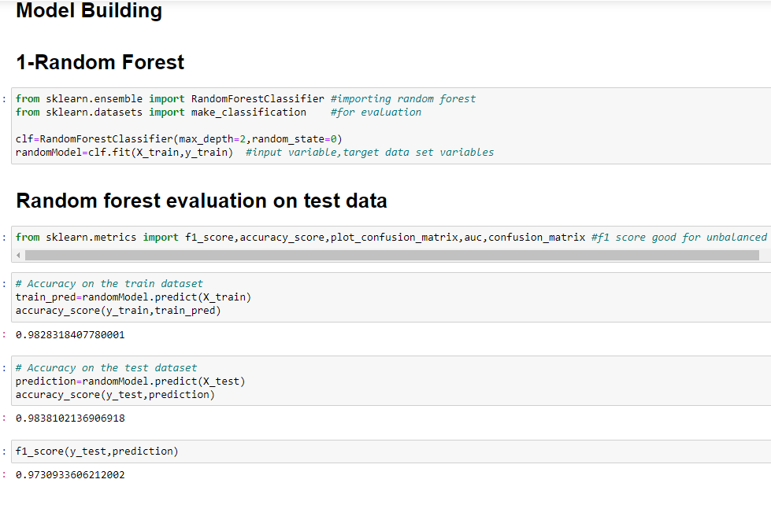
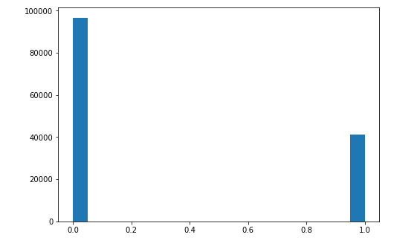
Model building
Here we are building the Random forest model and checking the accuracy on the training and test dataset. Because our dataset is unbalanced so we are considering this accuracy as our final result, we are calculating f1 score which is more suitable for unbalanced data.

Slide 6
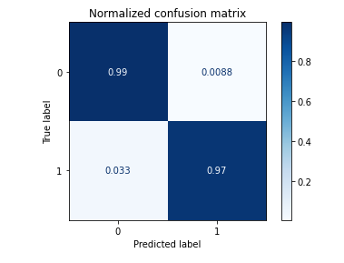
Confusion matrix
Here 0.99 means that the files was original file and our model said it was also original.0.0088 means that our file was original but our model said it was malware file. 0.97 means that the files was malware file and our model said it was also malware.0.033 means that our file was malware but our model said it was original file. Looking at the matrix we can conclude this model is performing well

Slide 7
Advantages
-It produces a highly accurate classifier and learning is fast
- It runs efficiently on large data bases.
- It can handle thousands of input variables without variable deletion

Slide 8
Logistic regression
Logistic regression is a classifier in which the target variable is categorical value
Logistic Regression is used when the dependent variable(target) is categorical.
For example,
To predict whether an email is spam or not

Slide 9
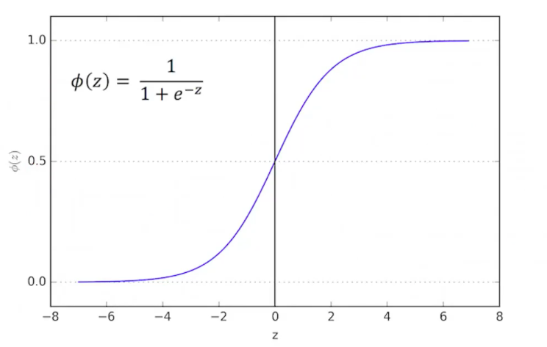
Logistic regression function
The equation given is know as the sigmoid function
Sigmoid function is converting the independent variable into a expression of probability
where z is the independent variable and Φ is the output
When the input is given to the function what it does is, it divides
the output into to class, class 1 where the chance of occurring is 1
and class 0 where chances of occurring is 0.
Class 1
Class 0

Slide 10
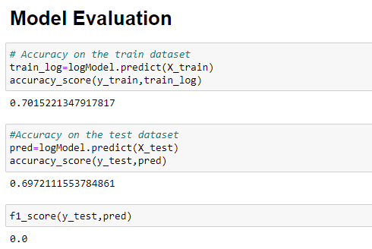
Model building
Here we are building the logistic regression model and checking the accuracy on the training and test dataset. Because our dataset is unbalanced so we are considering this accuracy as our final result, we are calculating f1 score which is more suitable for unbalanced data.

Slide 11
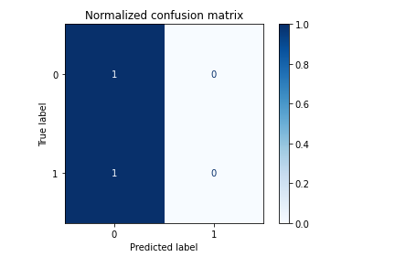
Confusion matrix
Here we can see that this model is not performing well, one reason could be that our dataset is unbalanced. Here upper left 1 is saying that the original file was also original. And the bottom 1 is saying that the file was malware but our model says its original one. Looking at this, model is not doing well.

Slide 12
Advantages
- Logistic regression is very efficient to train
- Good accuracy for many simple data sets
- It is very fast at classifying unknown records

Slide 13
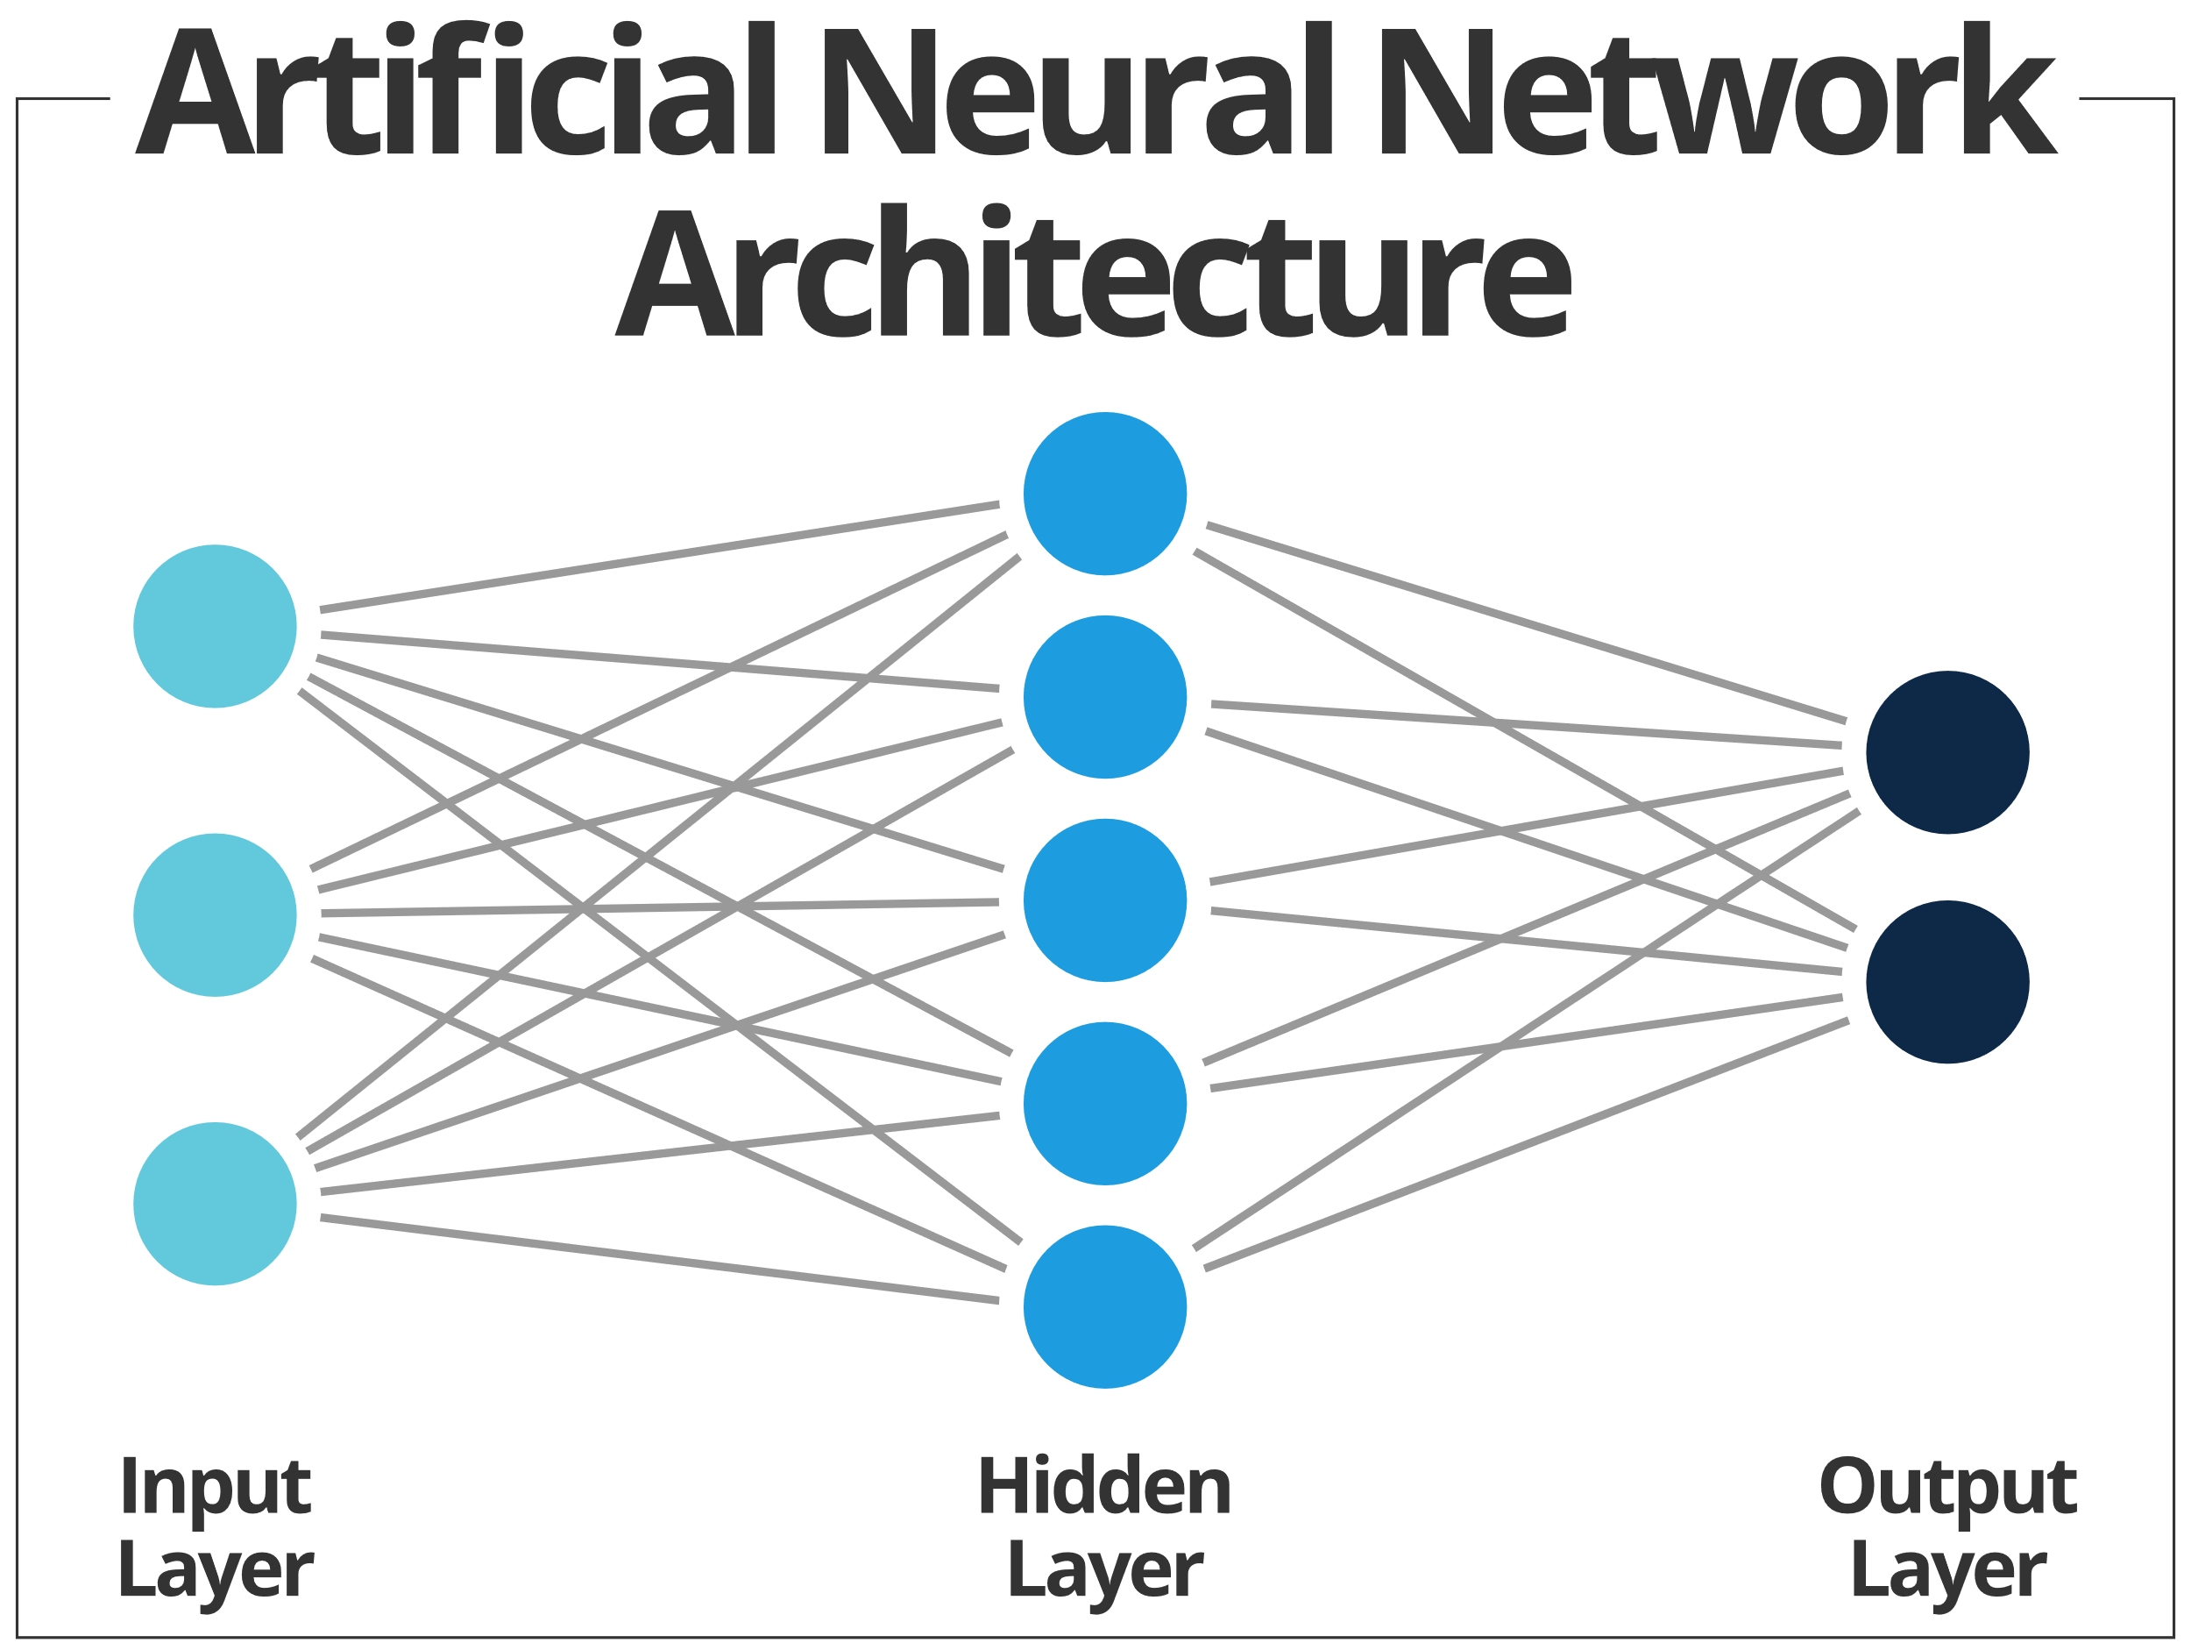
Neural Network
- A method of computing, based on the interaction of multiple connected processing elements.
- A powerful technique to solve many real world problems
- The ability to learn from experience in order to improve performance
- Ability to deal with incomplete information.

Slide 14
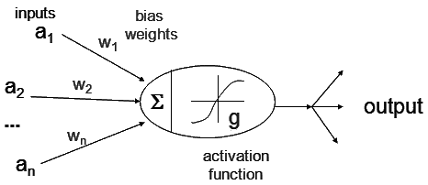
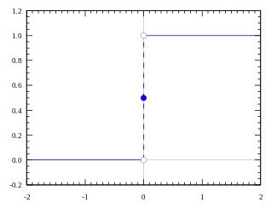
Neural Network Neuron
- Receive n- inputs
- Multiplies each input by its weight
- Applies activation function to the sum of result
- Output result
Activation function
- Controls when unit is active or inactive
- Threshold function outputs 1 when input is positive and 0 otherwise.

Slide 15
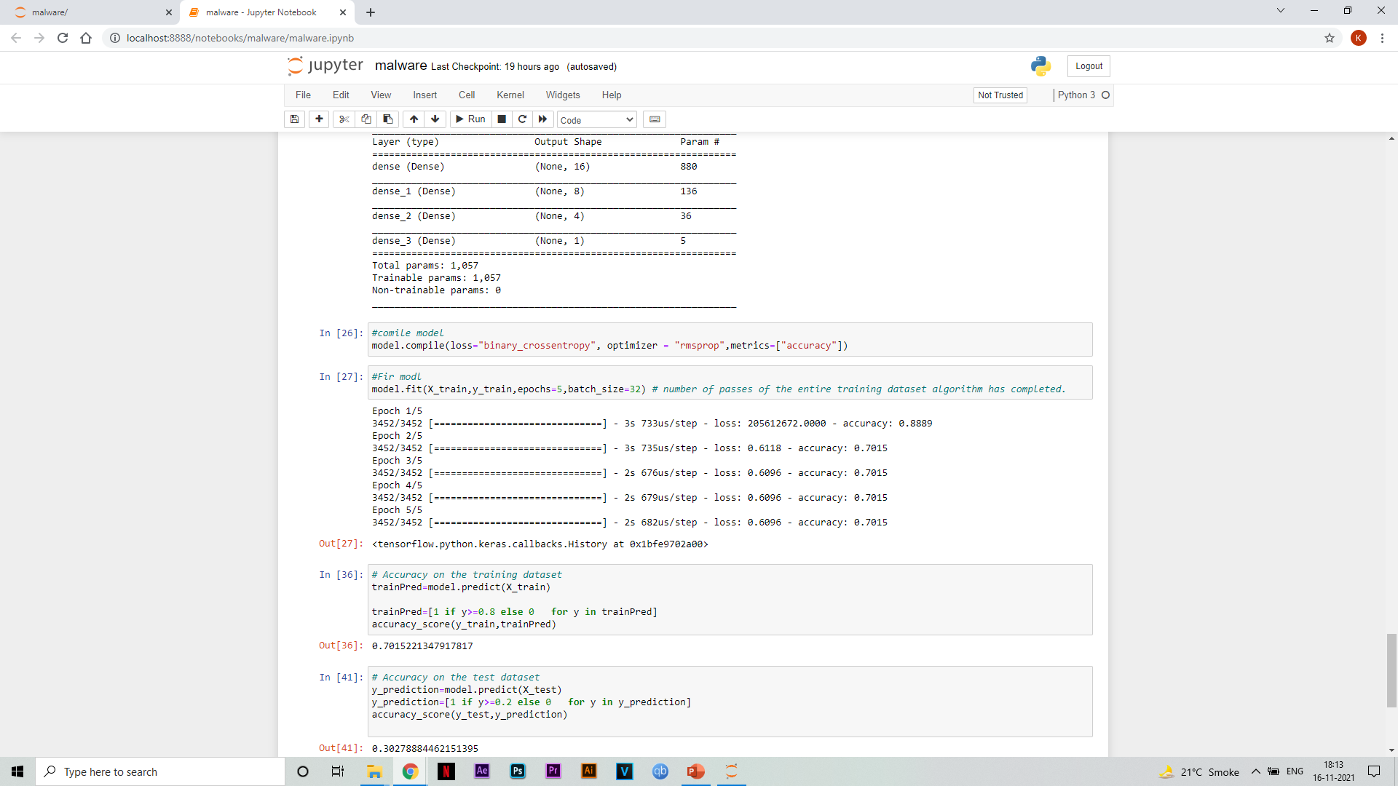
Model building
Here we are building the logistic regression model and checking the accuracy on the training and test dataset. Because our dataset is unbalanced so we are considering this accuracy as our final result, we are calculating f1 score which is more suitable for unbalanced data.

Slide 16
Advantages
- Store information on the entire network
-The ability to work with insufficient knowledge

Slide 17
Models performance comparison
Model | Train data accuracy | Test data accuracy | F1 score | Position
Random forest | 0.982 | 0.983 | 0.973 | 1st
Logistic regression | 0.70 | 0.69 | 0.0 | 3rd
Neural Network | 0.70 | 0.30 | 0.46 | 2nd

Slide 18
Conclusion
Comparing the accuracy of all the model Random forest comes in 1st place, then neural network and then logistic regression mode. So, Random forest is best model among these for datasets like these which is unbalanced.

